Slide 1
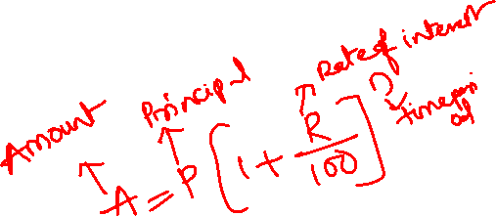
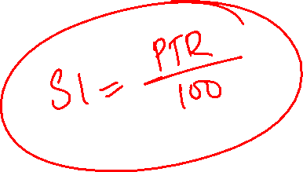
Compound Interest
Quantitative Aptitude

Slide 2
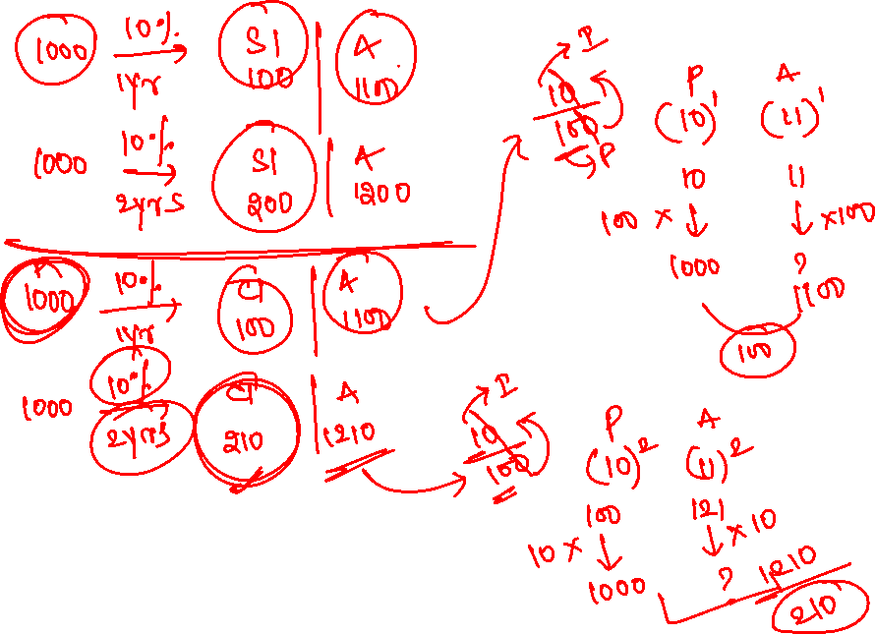

Slide 3
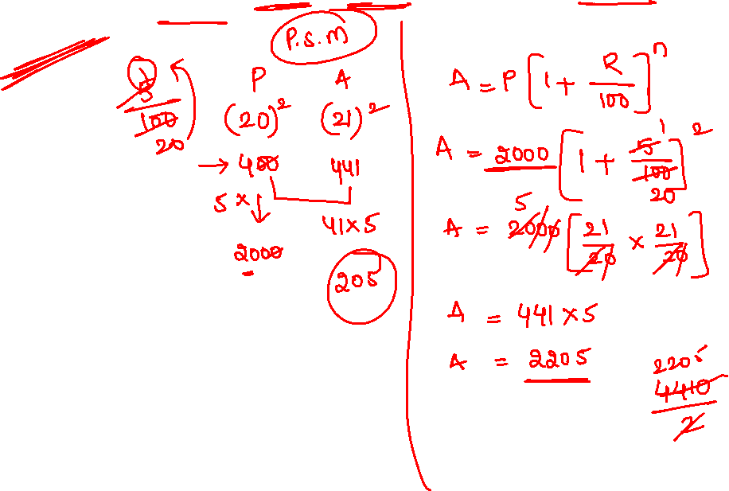
1. Find the compound interest on Rs. 2000 at 5% per annum for 2 years compounded annually?
205
210
220
230

Slide 4
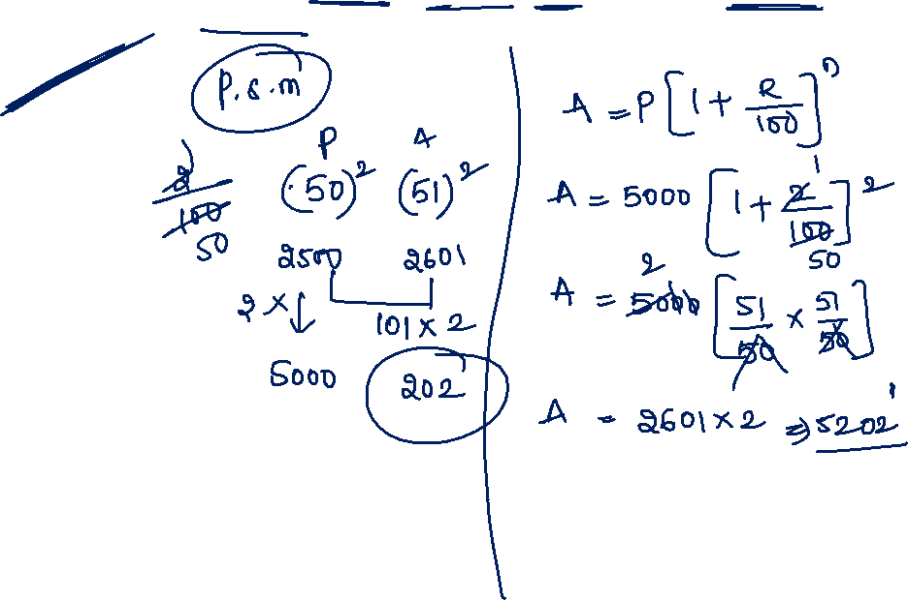
2. Find the compound interest on Rs. 5000 at 2% per annum for 2 years compounded annually?
202
222
210
220

Slide 5
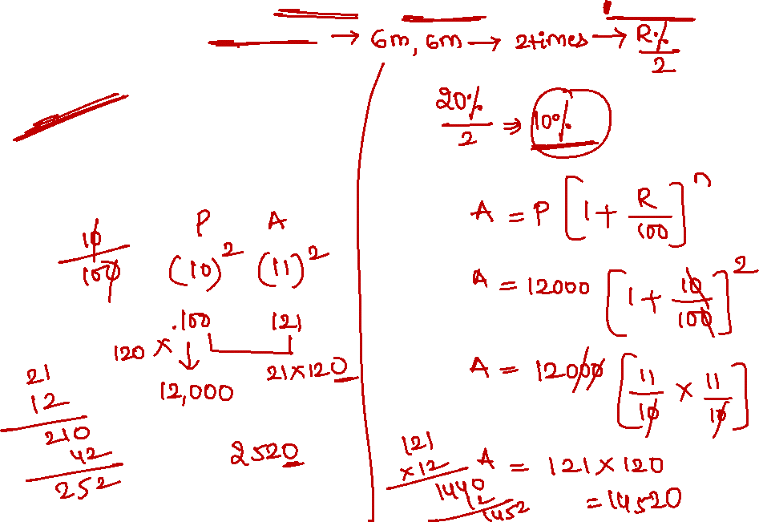
3. Compute the compound interest on Rs. 12,000 for 1 years ate 20% p.a. when compounded half-yearly.
2500
2520
2540
2300

Slide 6
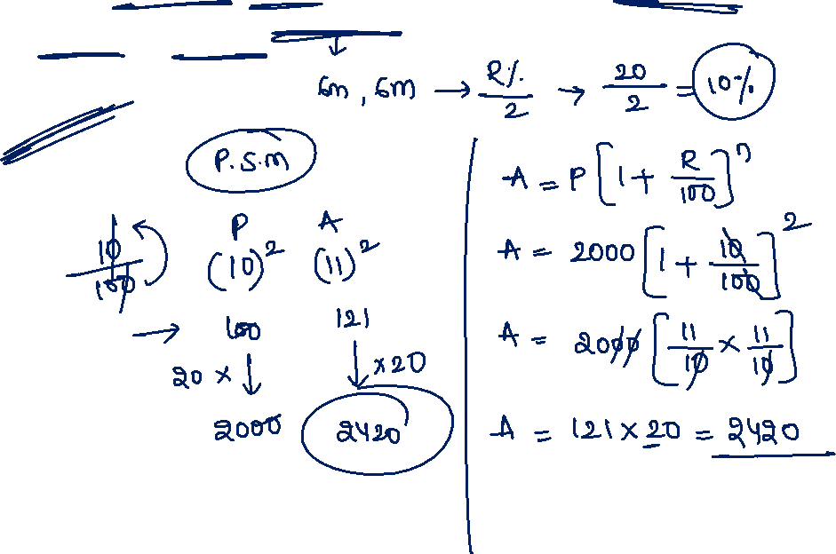
4. If ram deposited Rs. 2000 in savings account at the rate of 20 percent per annum compounded half-yearly, how much money will be in the account after one year
Rs. 3530
Rs. 2420
Rs. 2630
Rs. 3870

Slide 7
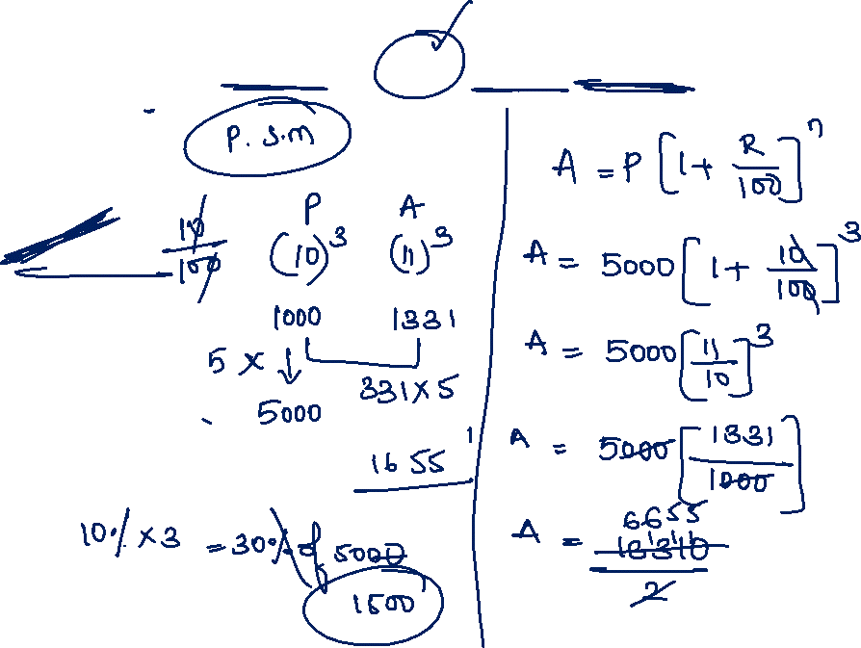
5. The compound interest on Rs. 5000 for 3 years at 10% per annum will amount to
5000
2500
1655
1500

Slide 8
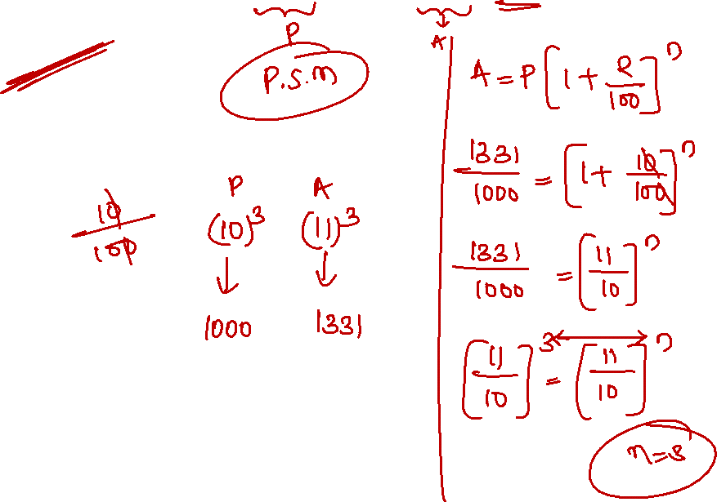
6. In what time will Rs. 1000 becomes Rs. 1331 at 10% per annum compounded Annually
3 years
2(1/2) years
2 years
3(1/2) years

Slide 9
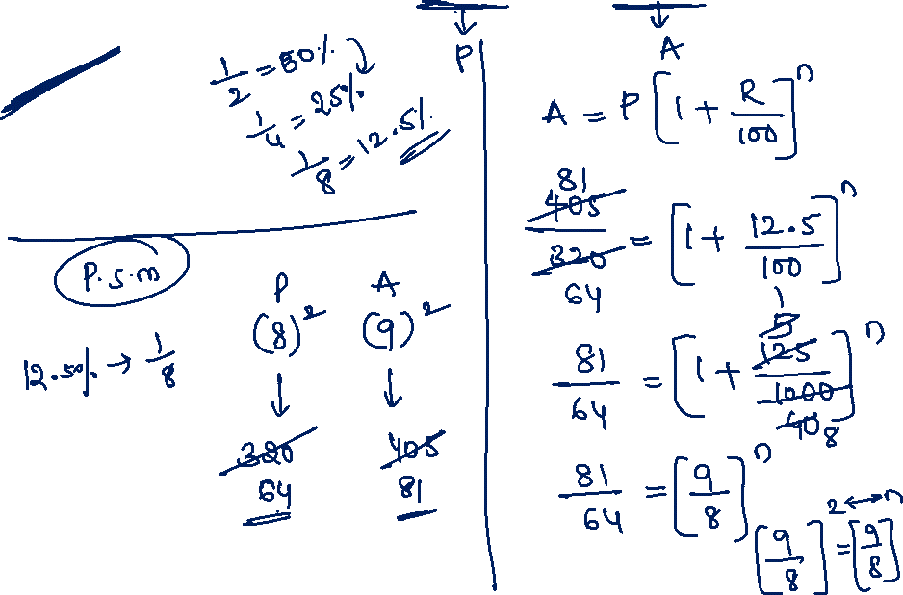
7. In how many years will a sum of Rs. 320 amount to Rs. 405. if interest is compounded at 12.5% per annum?
2 years
1 year
1(1/2) years
2(1/2) years

Slide 10
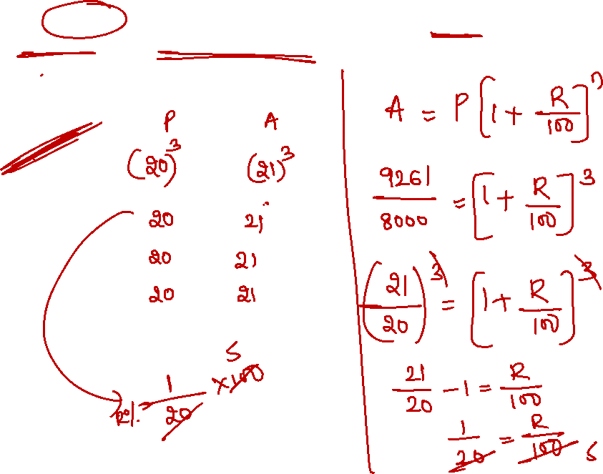
8. Rs. 8000 invested at Compound interest gives Rs. 9261 as interest after 3 years, the rate of interest per annum?
10%
6%
5%
1%

Slide 11
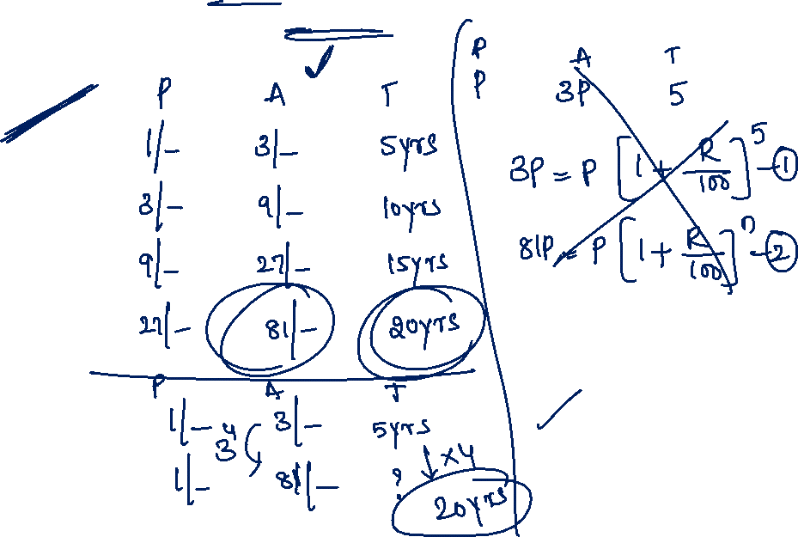
9. A sum of money triples itself in 5 years at compound interest. In how many years will it become 81 times of itself
15
20
25
30

Slide 12
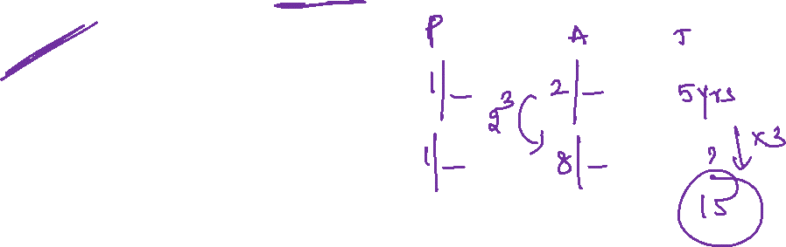
10. A sum of money double itself in 5 years at compound interest. In how many years will it become 8 times of itself
15
20
25
30

Slide 13
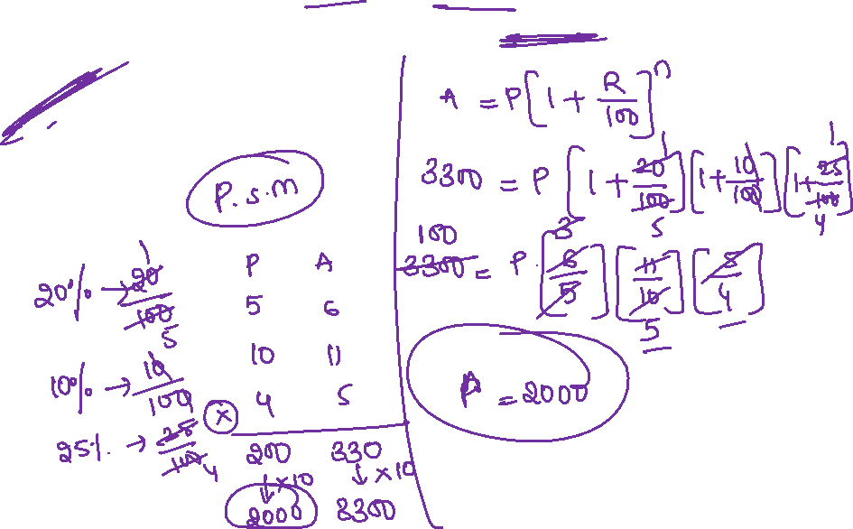
11. A sum of money is invested for 3 years at compound interest, the rate of interest being 20% p.a., 10% p.a. and 25% p.a. for the first, second and third years respectively. If the amount becomes Rs.3300, then find the sum.
Rs.2000
Rs.2400
Rs.2500
Rs.3000

Slide 14
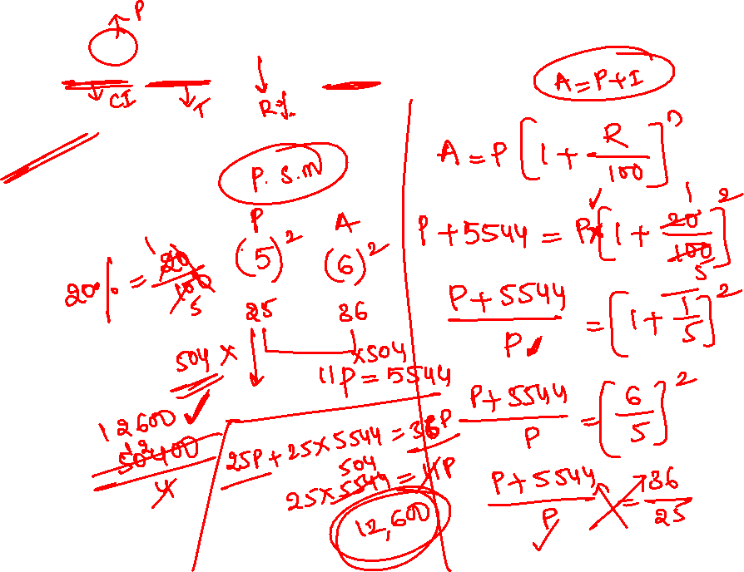
12. A sum invested at 20% p.a. compound interest gives an interest of Rs.5544 in 2 years. What is the sum invested?
Rs.12000
Rs.12600
Rs.13000
Rs.13600

Slide 15
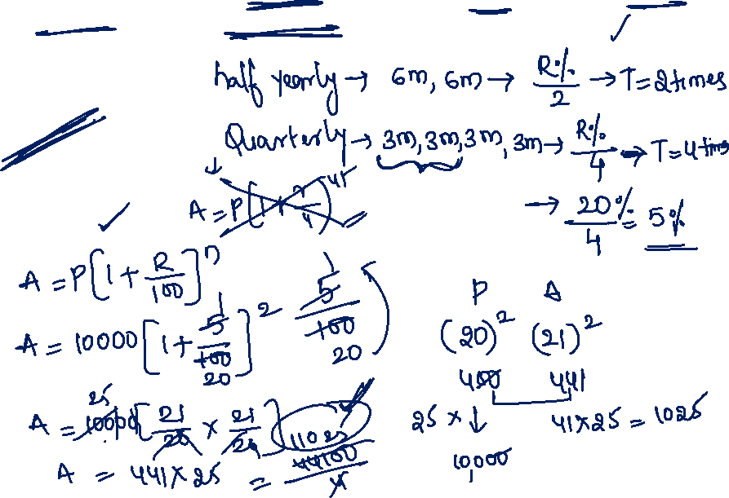
13. Find the Compound interest on Rs. 10,000 at 20% per annum for 6 months. Compounded Quarterly
Rs. 4353
Rs. 1329
Rs. 1025
Rs. 2649

Slide 16
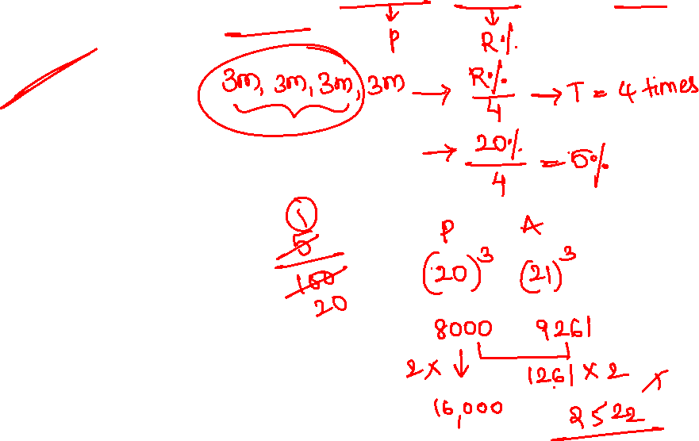
14. Find the compound interest on Rs. 16,000 at 20% per annum for 9 months compounded quarterly
2522
2422
2682
1261

Slide 17
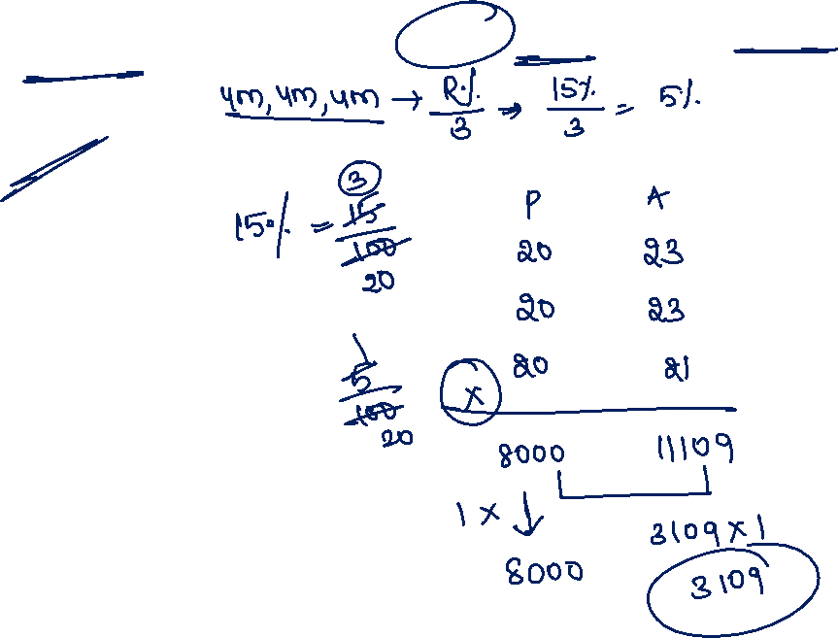
15. Find the compound interest on Rs. 8000 at 15% per annum for 2 years 4 months, compounded annually
2109
3109
4109
6109

Slide 18


